Slide 1
Ethical Issues In business LECTURE # 3

Slide 2
Fair Use Notice
The material used in this presentation i.e., pictures/graphs/text, etc. is solely intended for educational/teaching purpose, offered free of cost to the students for use under special circumstances of Online Education due to COVID-19 Lockdown situation and may include copyrighted material - the use of which may not have been specifically authorized by Copyright Owners. It’s application constitutes Fair Use of any such copyrighted material as provided in globally accepted law of many countries. The contents of presentations are intended only for the attendees of the class being conducted by the presenter.

Slide 3


Ethical Issue In Business
From factory working conditions at the turn of the 20th century, to today’s emphasis on diversity training, the history of workplace ethics is the ongoing story of the relationship between employees and employers. According to the National Business Ethics Survey , managers are to blame for workplace misconduct the majority (60%) of the time, and senior managers are more likely than those on a lower level to break the rules.

Slide 4
Here are some of the ethical issues that businesses face in real-world and how these ethical issues have affected companies.
Harassment and Discrimination in the Workplace
Health and Safety in the Workplace
Whistleblowing or Social Media Rants
Ethics in Accounting Practices
Technology and Privacy Practices
Nondisclosure and Corporate Espionage
Bad Leadership Behavior.

Slide 5

Harassment and Discrimination in the Workplace
Harassment and discrimination are arguably the largest ethical issues that impact business owners today. If harassment or discrimination take place in the workplace, the result could be catastrophic for your organization both financially and reputationally.
Every business needs to be aware of the anti-discrimination laws and regulations that exist to protect employees from unjust treatment. The U.S. Equal Employment Opportunity Commission (EEOC) defines many different types of discrimination and harassment statuses that can have an effect on your organization, including but not limited to:
Age: applies to those 40 and older, and to any ageist policies or treatment that takes place.
Disability: accommodations and equal treatment provided within reason for employees with physical or mental disabilities.
Equal Pay: compensation for equal work regardless of sex, race, religion, etc.

Slide 6
Harassment and Discrimination in the Workplace (continue…)
Pregnancy: accommodations and equal treatment provided within reason for pregnant employees.
Race: employee treatment consistent regardless of race or ethnicity.
Religion: accommodations and equal treatment provided within reason regardless of employee religion.
Sex and Gender: employee treatment consistent regardless of sex or gender identity.

Slide 7

Health and Safety in the Workplace
The International Labor Organization (ILO) states that 6,300 people die every day from occupational accidents or work-related diseases. This results in more than 2.3 million deaths per year.
However, health and safety concerns should not be limited to physical harm. In a 2019 report conducted by the International Labor Organization (ILO), an emphasis was placed on the rise of “psychosocial risks” and work-related stress and mental health concerns. Factors such as job insecurity, high demands, effort-reward imbalance, and low autonomy, were all found to contribute to health-related behavioral risks, including sedentary lifestyles, heavy alcohol consumption, increased cigarette smoking, and eating disorders.

Slide 8

Whistleblowing or Social Media Rants
The widespread nature of social media has made employees conduct online a factor in their employment status. The question of the ethics of firing or punishing employees for their online posts is complicated. However, the line is usually drawn when an employee’s online behavior is considered to be disloyal to their employer. This means that a Facebook post complaining about work is not punishable on its own but can be punishable if it does something to reduce business or maligning the organization or Institution.
In the same vein, business owners must be able to respect and not penalize employees who are deemed whistleblowers to either regulatory authorities or on social media. This means that employees should be encouraged, and cannot be penalized, for raising awareness of workplace violations online.

Slide 9

Ethics in Accounting Practices
Any organization must maintain accurate bookkeeping practices. “Cooking the books”, and otherwise conducting unethical accounting practices, is a serious concern for organizations, especially in publicly traded companies.

Slide 10

Technology and Privacy Practices
The developments in technological security capability pose privacy concerns for clients and employees alike. Employers now have the ability to monitor employee activity on their computers and other company-provided devices, and while electronic surveillance is meant to ensure efficiency and productivity, it often comes dangerously close to privacy violation. Because when does it cross the line and it become spying.
According to a 2019 survey conducted by the American Management Association, 66% of organizations were found to monitor internet connections, with 45% tracking content, keystrokes, and time spent on the keyboard, and 43% storing and reviewing computer files as well as monitoring employee emails. The key to using technological surveillance in an ethical manner is transparency. According to the same survey, 84% of those companies tell their employees that they are reviewing computer activity. In order to ensure employee surveillance does not turn into an ethical issue for your business, both employees and employers should remain conscious of the actual benefits of being monitored, and whether it is a useful way of developing a record of their job performance.

Slide 11
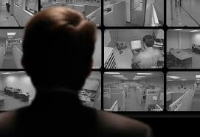
Technology and Privacy Practices (Contiue…)
Companies also monitor employees through video cameras, which allows them to observe visually and record employee behavior and keep their work environment safe. According to some data , the majority of respondents (54%) found installing surveillance cameras that have facial recognition technology acceptable, where as, some participants stating, “It would keep the workplace safe and may also get the employees to perform their best.” Some employees were unsure and said it depended on how the footage is used while others completely disagreed: “Monitoring work by camera is insane,” and thought it would hinder rather than help work performance.

Slide 12

Nondisclosure and Corporate Espionage
Many employers are at risk of current and former employees stealing information, including client data used by organizations in direct competition with the company. When intellectual property is stolen, or private client information is illegally distributed, this constitutes corporate espionage. Companies may put in place mandatory nondisclosure agreements, stipulating strict financial penalties in case of violation, in order to discourage these types of ethics violations.

Slide 13

Bad Leadership Behavior
Bad leadership behavior is also one of the major factors now a days in any organization that comes in the ethical issue. Here are the top 10 things a bad leader does:
Takes credit for employees’ work
Lacks trust in employees
Overworks people
Refuses to advocate for employees’ compensation
Hires or promotes the wrong people
Shifts blame in disputes between employees and clients
Fails to provide direction
Micromanages
Focuses on employees’ weaknesses more than their strengths
Fails to set clear expectations

Slide 14
Final Thoughts on Addressing Ethical Issues in Business
Avoiding ethical issues in business always starts with top management. Providing clearly written policies and processes that ensure those policies are acknowledged and can ensure transparency and ethical business practices are applied.
In order to effectively detect and, most importantly, deter ethical issues in business from surfacing in your organization, there are several everyday efforts you can take. Be sure to communicate and enforce a robust code of ethics when making decisions and ask the same of your employees. Remain aware of the discrimination laws that exist in your region. Stay informed on the rules that impact your industry, and ensure your organization is acting in compliance with those regulations. Collaborate with accountants, maintaining transparency and honesty in your financial reports. It can also be prevented in the workplace by using a two-sided approach. First, your company must educate employees about what is considered an ethical conflict. Education can occur in training sessions or during meetings for other matters. Second, company leaders must set an example for lower-level employees. Be present in your company, making sure your organization and employees alike are always doing the right and ethical thing.

Slide 15

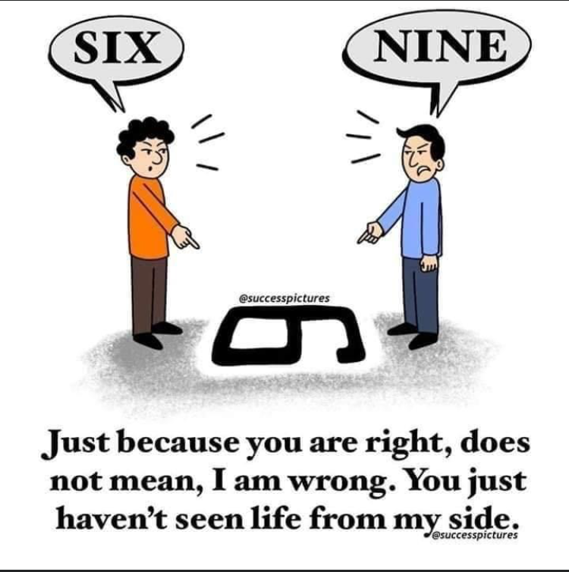



Lesson For Life

Slide 16
Thank you… Questions….??? If Any…

